Slide 1
Small Project
Wilderness Contacts

Slide 2
Team Members
Project Manager: Joseph Finfrock
Frontend: Istiaqul Alam and Ashton Williams
API: Monica Castro-Suarez and Marieclaire Guzman Reyes
Database: Allen Lin

Slide 3


Demonstration
http://cop4331group2.com/
Color Palette

Slide 4
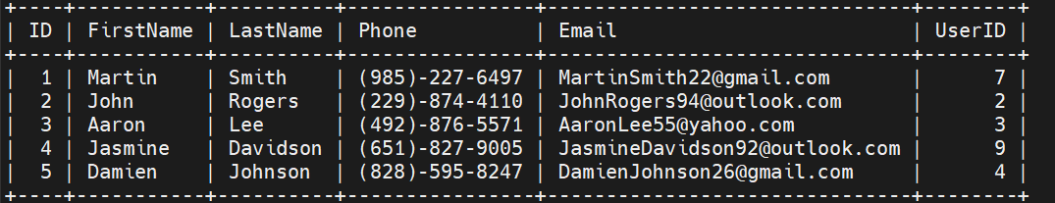
Database

Slide 5
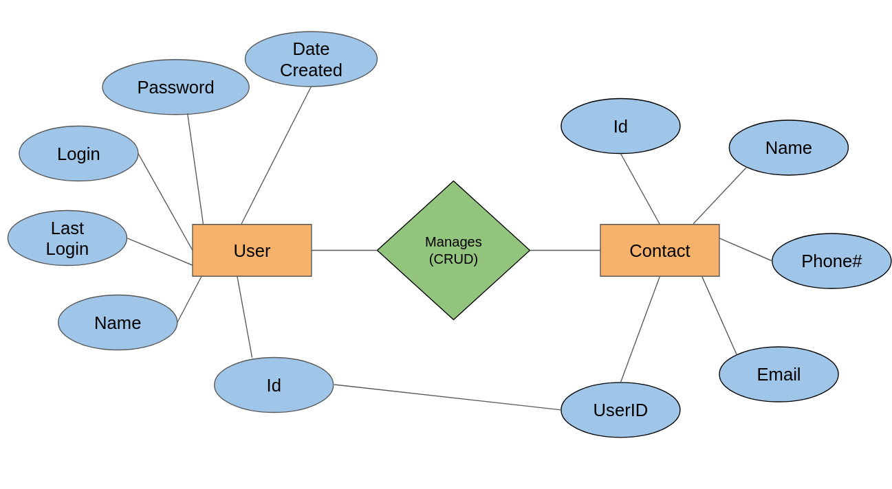
Entity Relation Diagram (ERD)

Slide 6
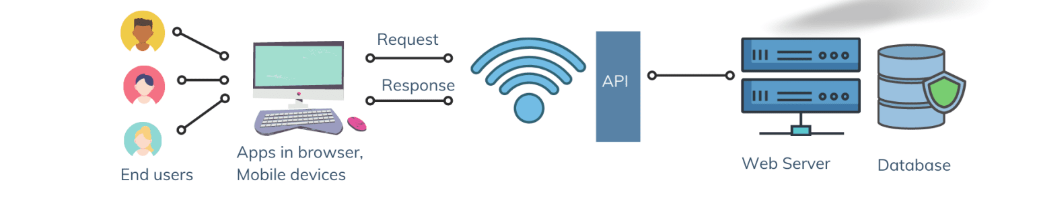
API/Swagger Hub
https://app.swaggerhub.com/apis/MO417925_1/COP4331/1.0.0

Slide 7
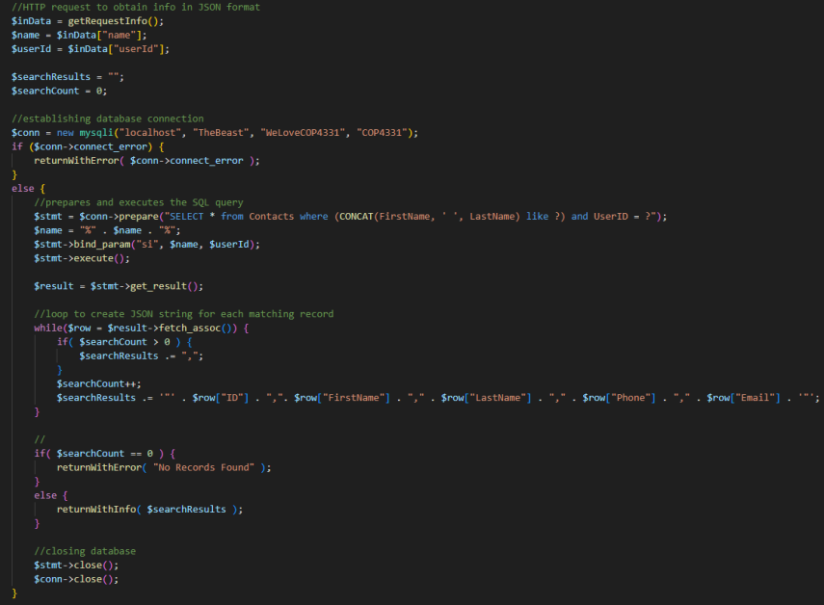
API Code

Slide 8
Things that went well
Project was consistently on schedule
No problems with team dynamics
Frontend uses bootstrap
No duplicate usernames for users

Slide 9
Things that went wrong
No major issues except that a team member did get too sick to work for a while, but because we were already on schedule everything worked out.

Slide 10
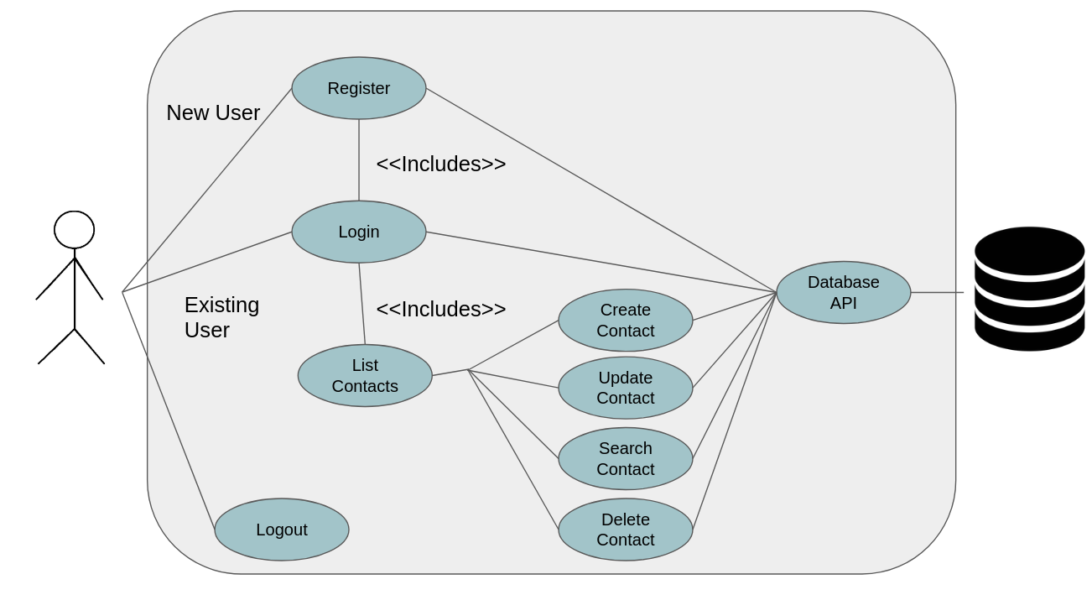
Use case diagram

Slide 11
Technologies used
LAMP stack for the webserver
HTML, CSS (With bootstrap), and JS for front end
Discord for team coordination and meetings
Github for hosting project code
Postman for API testing
Swagger hub for API documentation

Slide 12
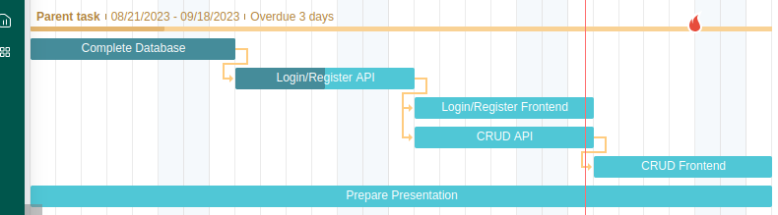
Gantt Chart
Gantt Chart was made fairly early into the project so it actually ended up being useful and kept us on track.

Slide 13
Questions

